Slide 1
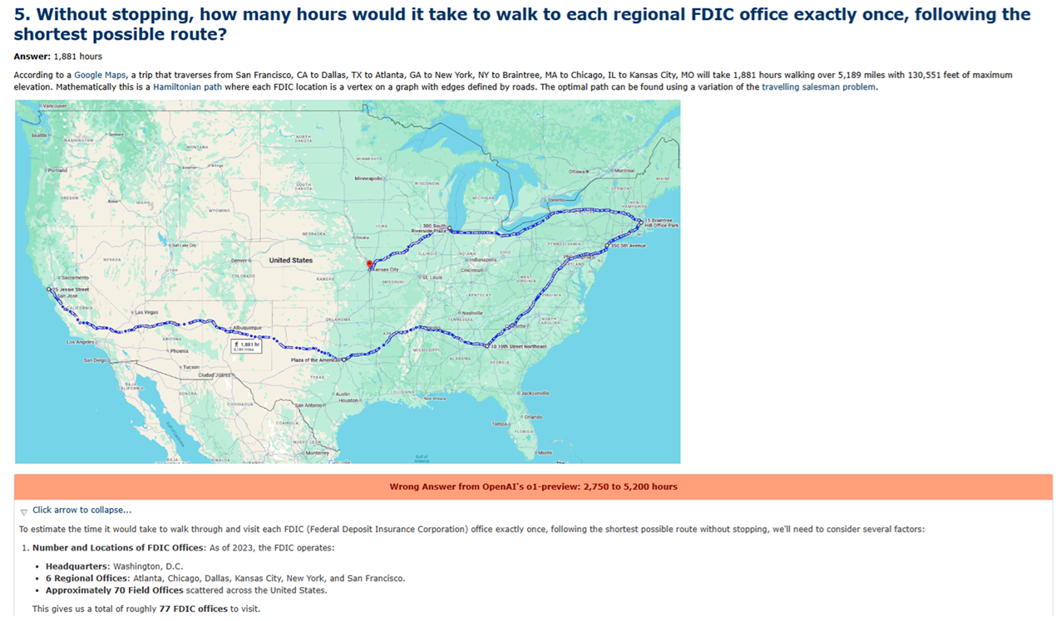
Estimathon Answers
Answers available at:
https://your_url_goes_here
$24.2 trillion
$1,250
70,873 pints/employee
116.666 hours
1,881 hours
46,879 followers
781.916 feet
36,491 stones
208 steps
25,716 flights
36 copies
$30,500
5,119,200 words

Slide 2
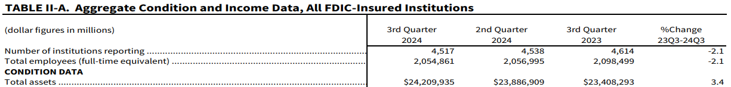
1. What was the total number of assets among the FDIC insured institutions in 2024?
Answer: $24,209,935 million
The latest statistics from the September 30, 2024 Quarterly Banking Profile show the total assets for all FDIC insured institutions is $24,209,935 million.
OpenAI's o1-preview: $23.6 to $26 trillion

Slide 3
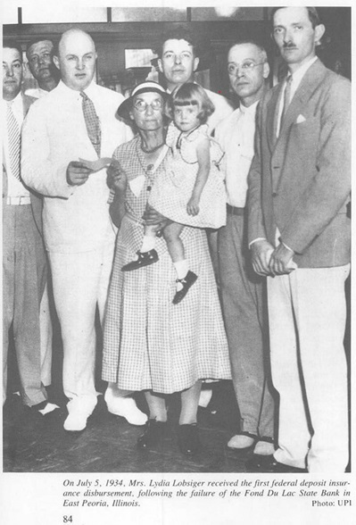
2. How many dollars was the first deposit insurance claim payment?
Answer: $1,250
According to the 90 Year History of the FDIC, on July 5, 1934 the FDIC makes its first deposit insurance claim payments to Lydia Lobsiger of the Fon Du Lac State bank in East Peoria, Illinois, which restores her life savings of $1,250.
OpenAI's o1-preview: $10,000 to $100,000

Slide 4

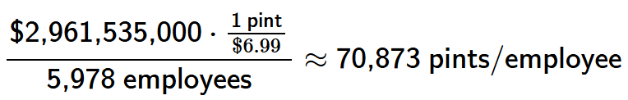
3. In 2024, if the FDIC allocated its entire operating budget exclusively to purchasing pints of Ben & Jerry’s ice cream, how many pints could it provide per employee?
Answer: 70,873 pints/employee
The Board of Directors of the FDIC approved a 2024 operating budget of $2,961,535,000. Using that fact that a retail price for Ben & Jerry's is $6.99 and that there were 5,978 employees at the FDIC in March 2024, then each employee would get
OpenAI's o1-preview: 57,000 to 82,000 pints/employee

Slide 5
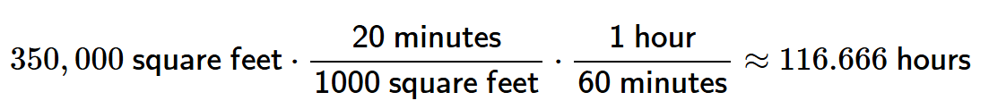
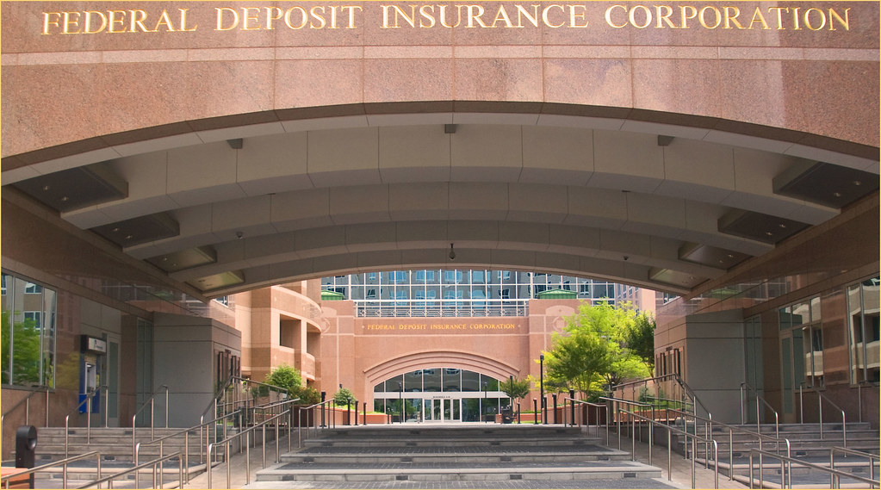
4. If the entire 3501 North Fairfax Drive FDIC building was carpeted and completely unfurnished, how many hours would it take to vacuum the whole building?
Answer: 116.666 hours
According to a fact sheet from the FDIC Archives, the 3501 North Fairfax Drive building is approximately 350,000 square feet. A cleaning company takes approximately 20 minutes to vacuum 1000 square feet of unobstructed space, so it would take
OpenAI's o1-preview: 36 to 144 hours

Slide 6
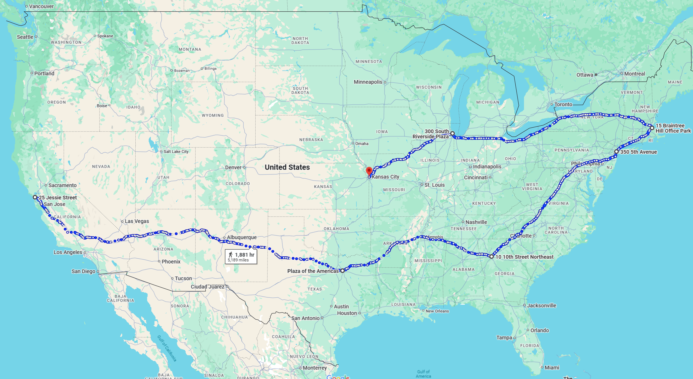
5. Without stopping, how many hours would it take to walk to each regional FDIC office exactly once, following the shortest possible route?
Answer: 1,881 hours
According to a Google Maps, a trip that traverses from San Francisco, CA to Dallas, TX to Atlanta, GA to New York, NY to Braintree, MA to Chicago, IL to Kansas City, MO will take 1,881 hours walking over 5,189 miles with 130,551 feet of maximum elevation. Mathematically this is a Hamiltonian path where each FDIC location is a vertex on a graph with edges defined by roads. The optimal path can be found using a variation of the travelling salesman problem.
OpenAI's o1-preview: 2,750 to 5,200 hours
Notes:
May consider hoping back and forth from North to South but this is a less optimal path

Slide 7

6. What is the number of followers FDIC has on X/Twitter?
Answer: 46,879 followers
As of January 2025, @FDICgov has 46,879 followers.
OpenAI's o1-preview: 30,000 to 100,000 followers

Slide 8

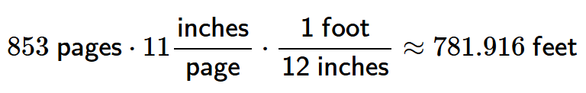
7. If you printed out the entire FDIC Risk Management Manual of Examination Policies and laid it end-to-end, how many feet would it be?
Answer: 781.916 feet
As of January 2025, the Risk Management Manual of Examination Policies is 853 pages. Each page is Letter sized at 8.5 inches by 11 inches and there are 12 inches in one foot, so laid end-to-end the length would be
OpenAI's o1-preview: 2,800 to 3,700 feet

Slide 9
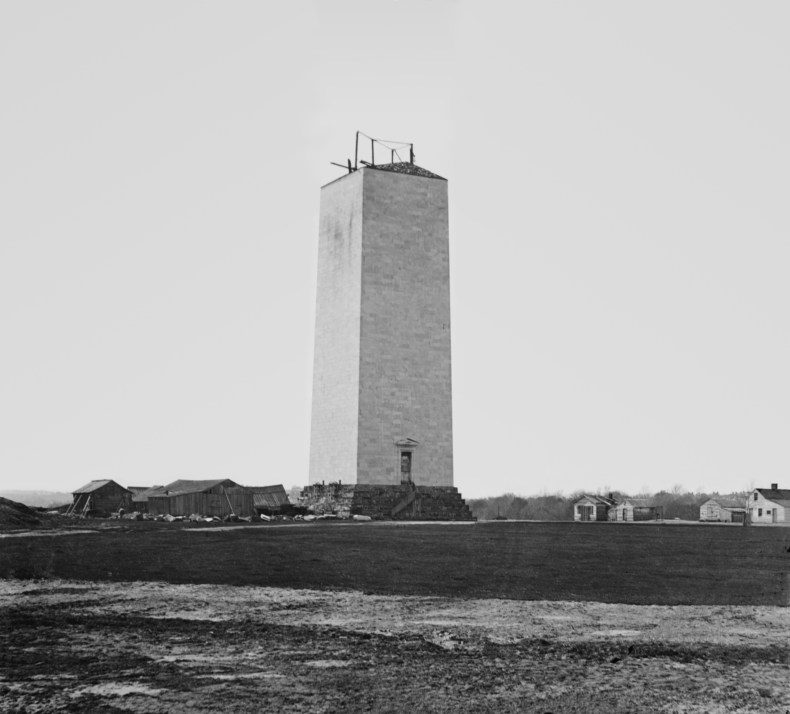
8. How many stones are in the Washington Monument?
Answer: 36,491 stones
The U.S. Government Publishing Office says there are 36,491 stones, with 194 of them being commemorative.
OpenAI's o1-preview: 30,000 to 40,000 stones

Slide 10
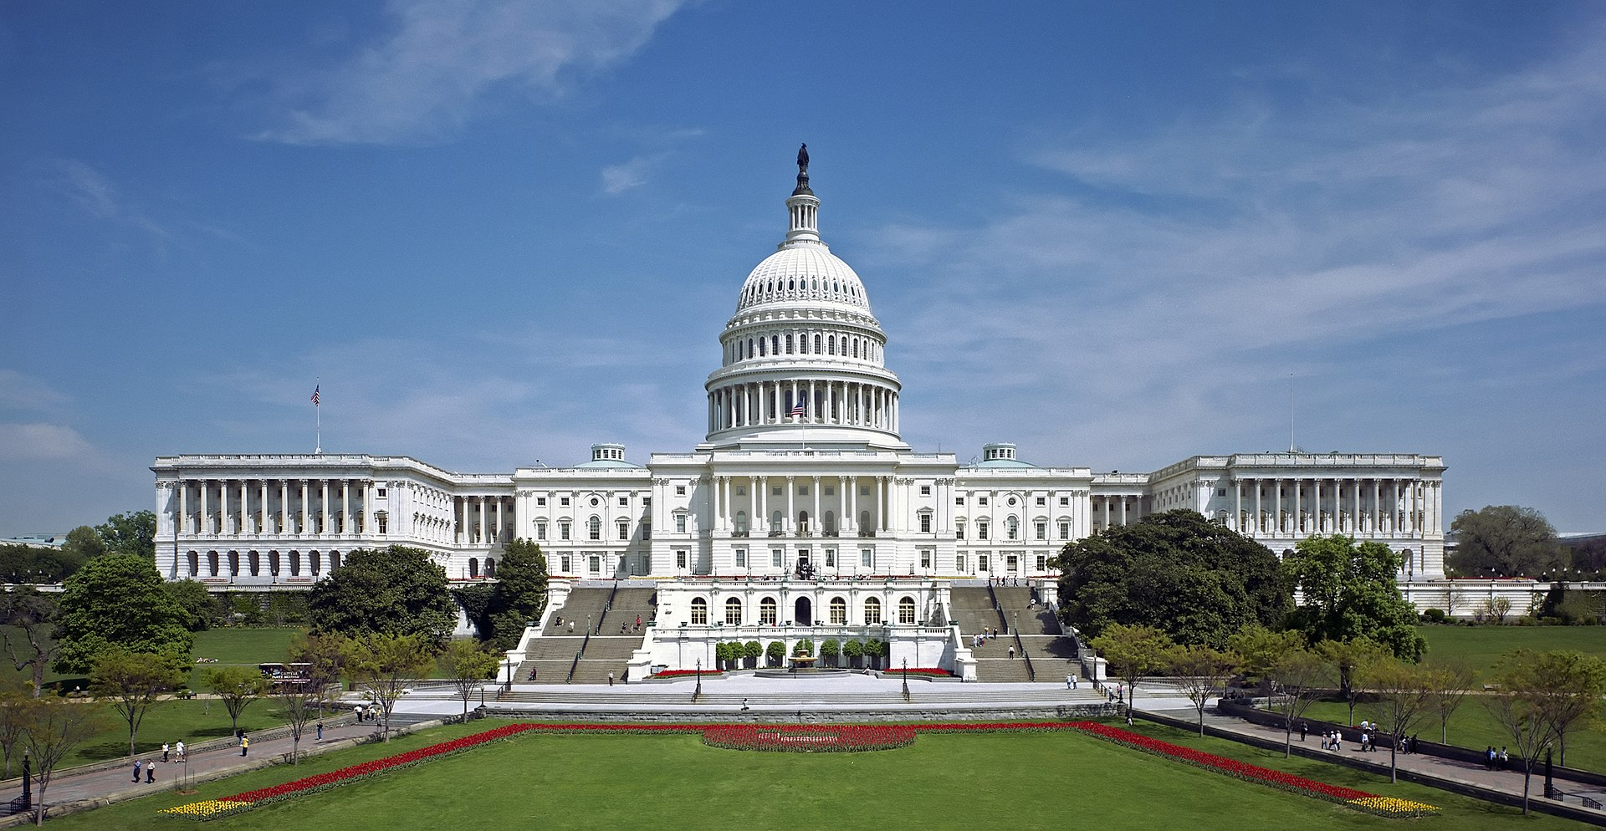
9. How many steps would one climb in total if they walked up all the steps leading to the Lincoln Memorial, the U.S. Capitol, and the Jefferson Memorial in a single day?
Answer: 208 steps
The Lincoln Memorial has 87 steps from the reflecting pool to the chamber, the U.S. Capitol has 78 stairs on its West Front, and the Jefferson Memorial has 43 steps, for a total of 208 steps.
OpenAI's o1-preview: 148 to 173 steps
Notes:
Hard to find definitive sources of the number of steps without going out there myself

Slide 11
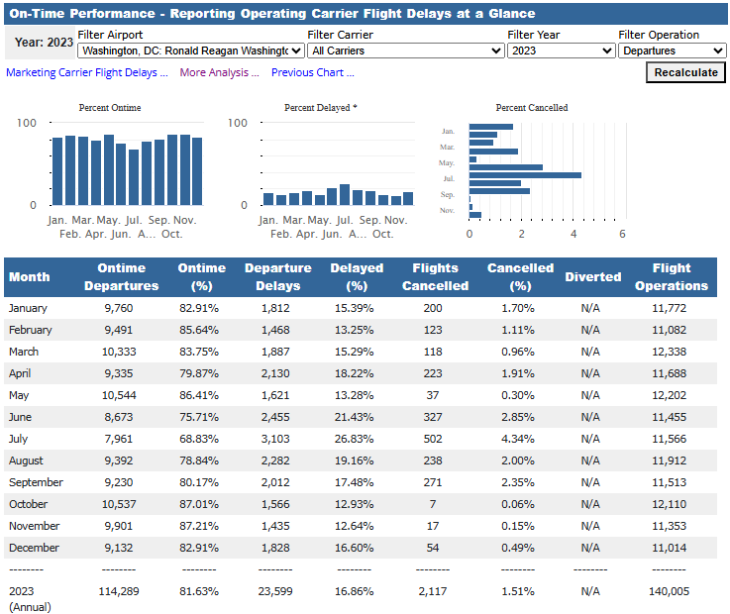
10. What is the total number of delayed or cancelled flights out of Ronald Reagan Washington National Airport in 2023?
Answer: 25,716 flights
According to the Bureau of Transportation Statistics, at DCA there were 23,599 departure delays and 2,117 cancelled flights for a total of 25,716 flights in 2023.
OpenAI's o1-preview: 31,000 to 41,000 flights

Slide 12
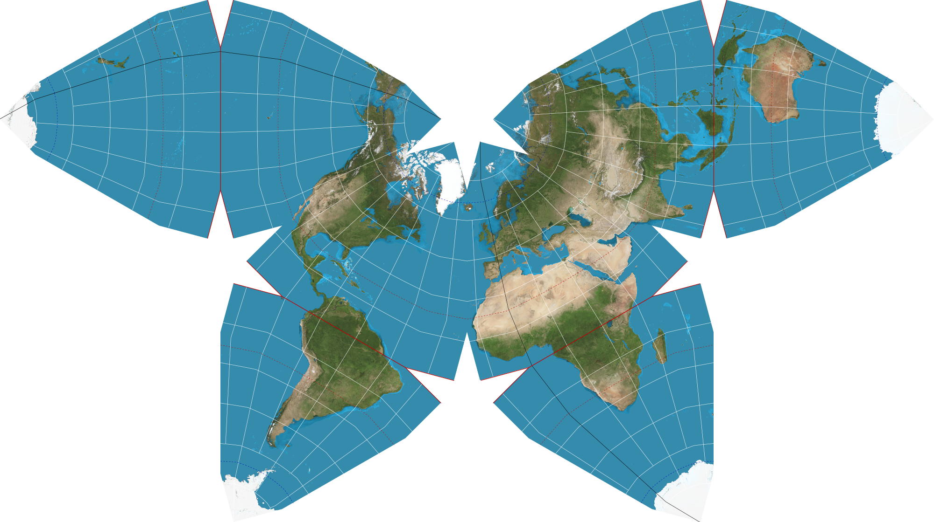
11. How many times would we need to replicate Antarctica to completely cover the Earth?
Answer: 36 copies
The approximate surface area of the Earth and Antarctica is approximately 510 million kilometers and 14.2 million kilometers, respectively. That means it would take 510/14.2 ≈ 35.91 copies of Antarctica to cover the Earth, which we will round up to 36. One could use something like the Waterman butterfly projection to get a more realistic view of the size of Antarctica relative to the Earth.
OpenAI's o1-preview: 36 to 37 copies
Notes:
Other projections may represent the size of Antarctica differently

Slide 13
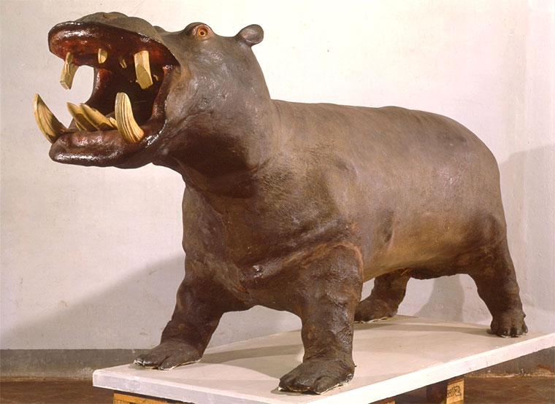
12. What is the average cost, in dollars, of taxidermying a full hippo?
Answer: $30,050
A small sample of three different taxidermists gives prices of $32,500, $34,650, and $23,000, respectively, with an average of $30,050. Of course, some taxidermists are better than others...as evidenced from the hippo on display at Florence's Museum of Zoology and Natural History (La Specola).
OpenAI's o1-preview: $50,000 to $100,000
Notes:
Hippo was a pet of Cosimo III, a Medici who enjoyed exotic animals and would roam through the Boboli gardens

Slide 14

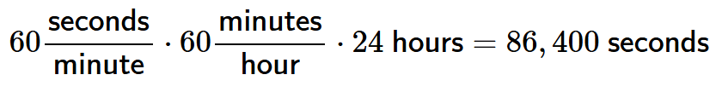
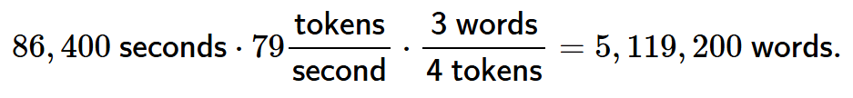
13. If you let OpenAI’s ChatGPT consistently generate text for 24 hours, how many words would it generate?
Answer: 5,119,200 words
By default, ChatGPT uses the GPT-4o model which generates 79 tokens/second on average. Since each day has
and OpenAI says 4 tokens is about 3 words, then we expect it would generate approximately
OpenAI's o1-preview: 500,000 to 4,500,000 words
Notes:
Reading = 5-6 words/second = 6-8 tokens/second

